Slide 2
Project: cse 2100
PROJECT NAME: GRE for Dummies
Under Supervision of:
Saifuddin Mahmud
Lecturer
Department of Computer Science And Engineering, KUET
Project by:
Ahmad Musa (1207021)
&
Faisal Ahmed (1207044)

Slide 3
Introduction to GRE for Dummies
An application written in Java programming language
An application that helps to study and take test on GRE math topics.

Slide 4
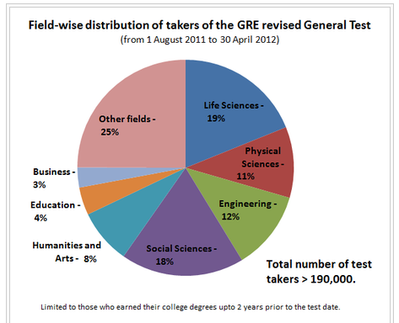

Slide 5
How to Use GRE for Dummies

Slide 6
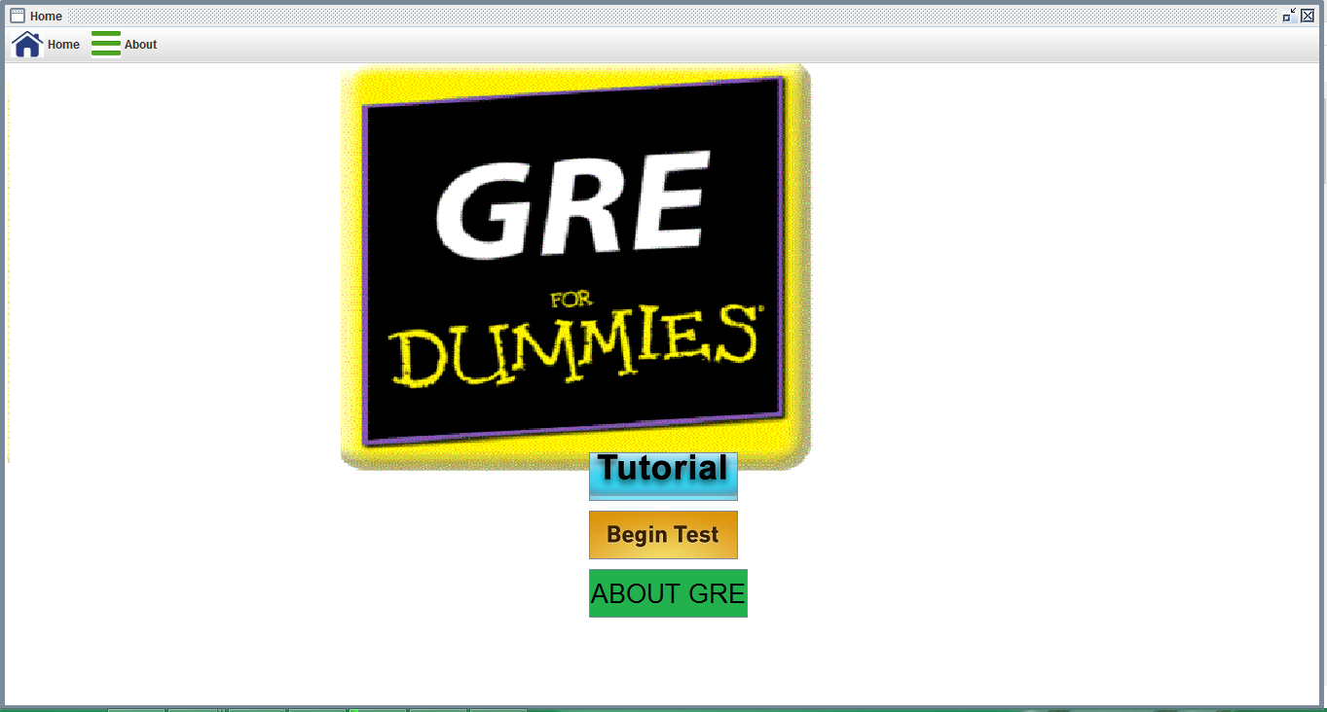
How to Use GRE for Dummies
Home Page

Slide 7
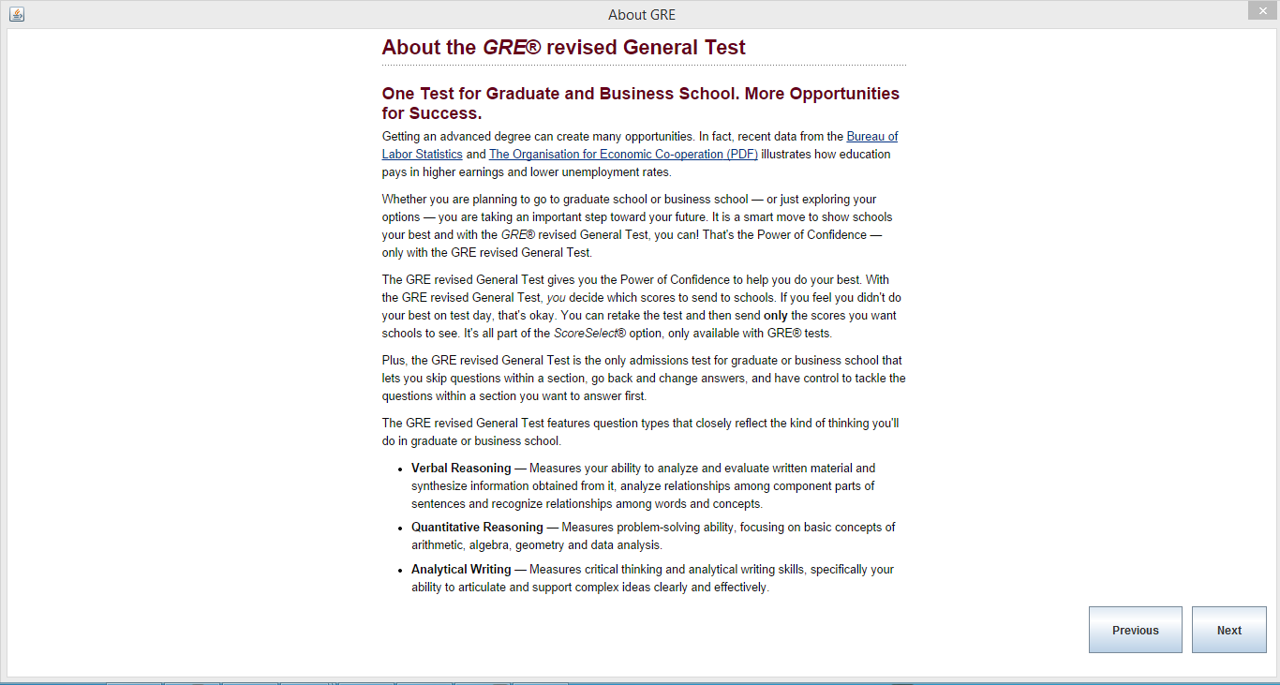
How to Use GRE for Dummies(contd.)

Slide 8
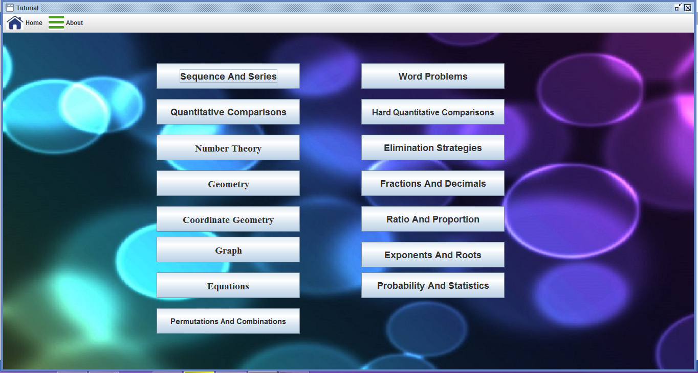
How to Use GRE for Dummies
Study from Tutorial

Slide 9
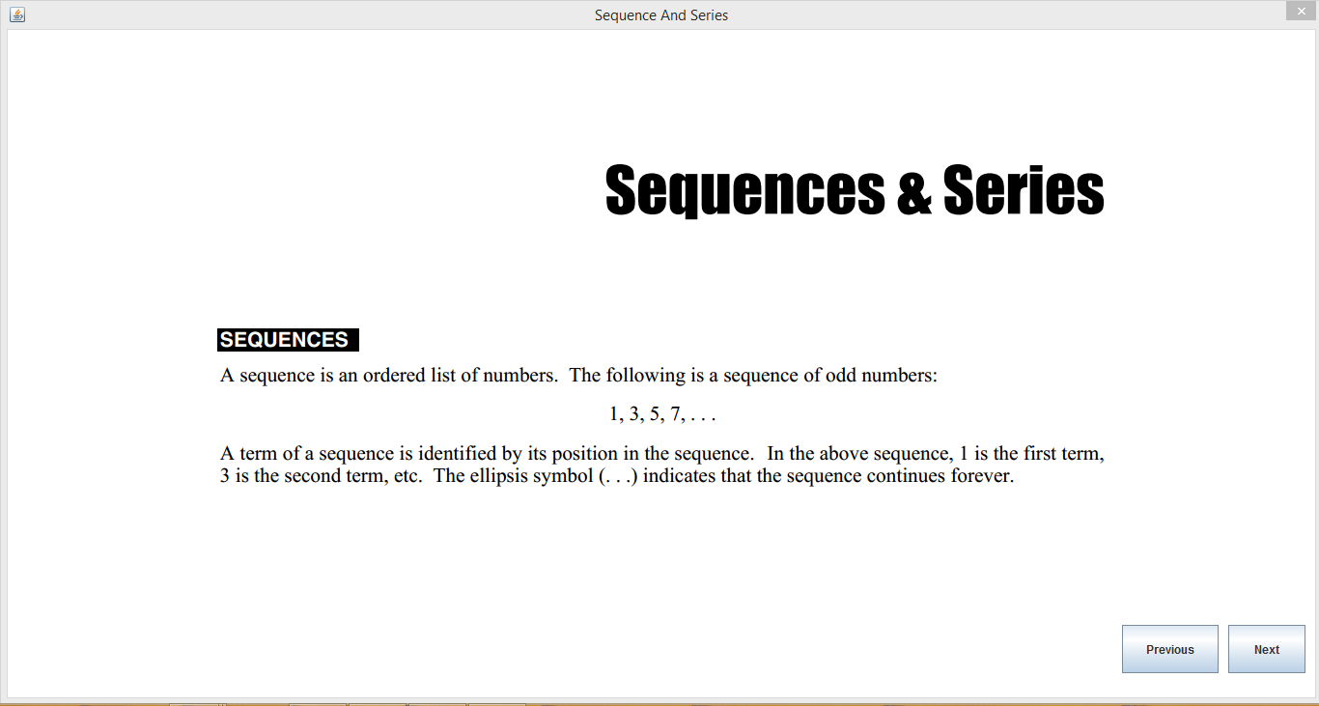
How to Use GRE for Dummies

Slide 10
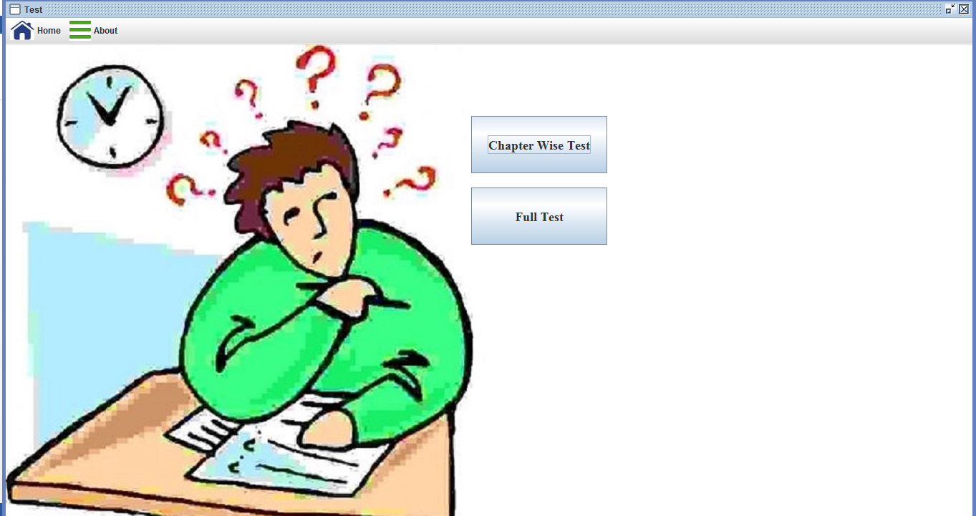
How to Use GRE for Dummies(contd.)
Two practice Test option

Slide 11
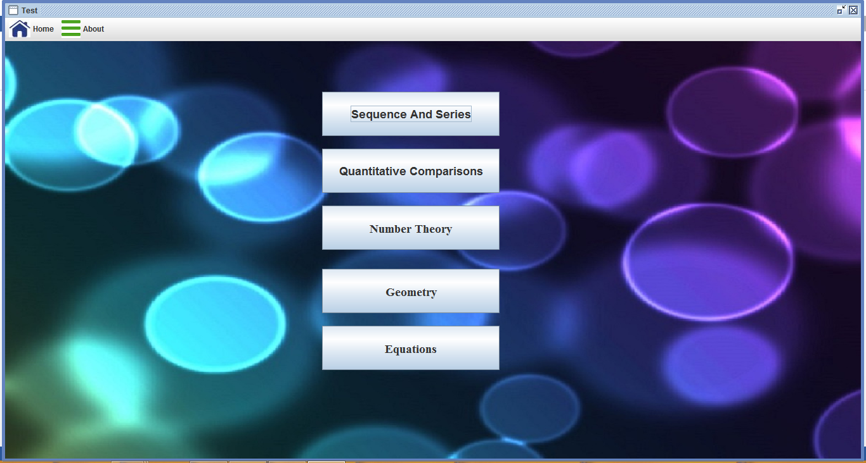
How to Use GRE for Dummies
Chapter Wise Test

Slide 12
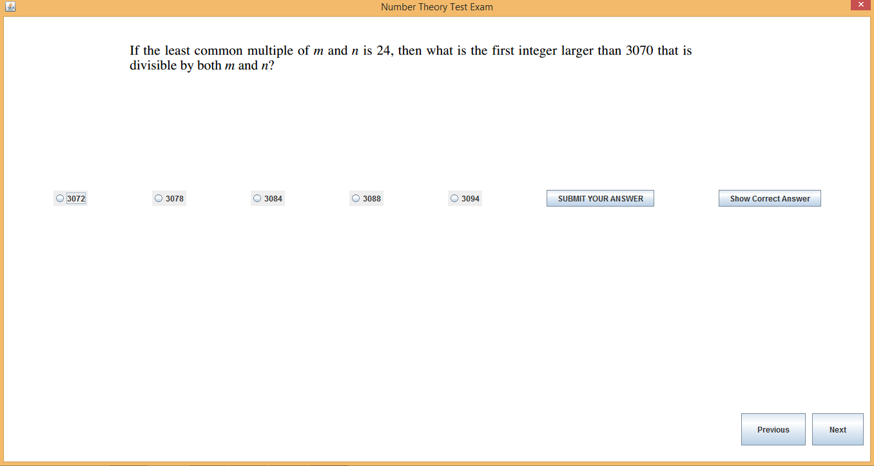
How to Use GRE for Dummies(contd.)

Slide 13
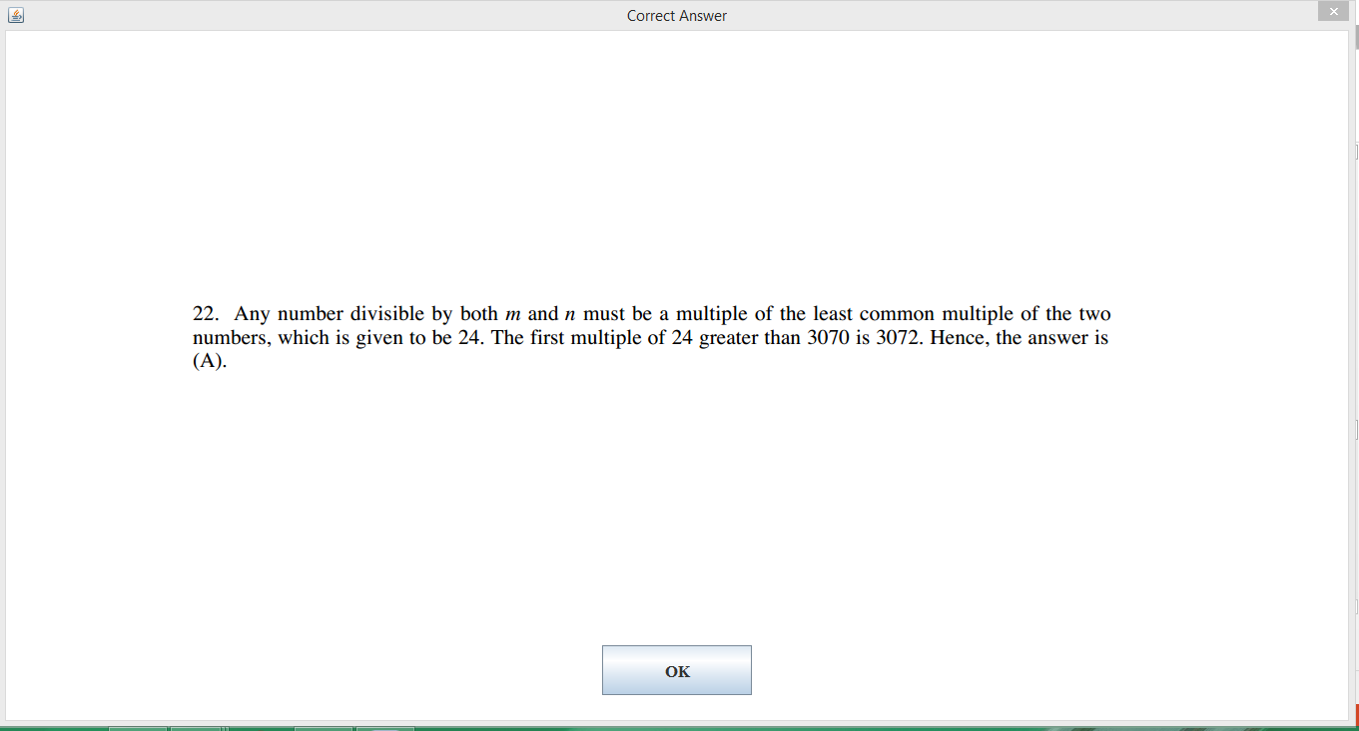
How to Use GRE for Dummies(contd.)

Slide 14
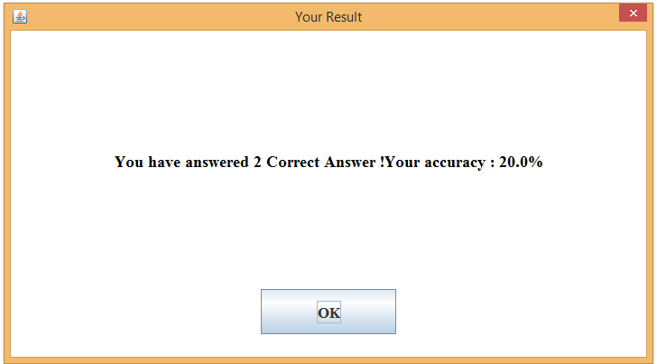
How to Use GRE for Dummies(contd.)

Slide 15
The making of GRE for Dummies
The project consists of
1 package
more than 30 classes
Around 140 methods

Slide 16
The Class diagram in GRE for Dummies

Slide 17
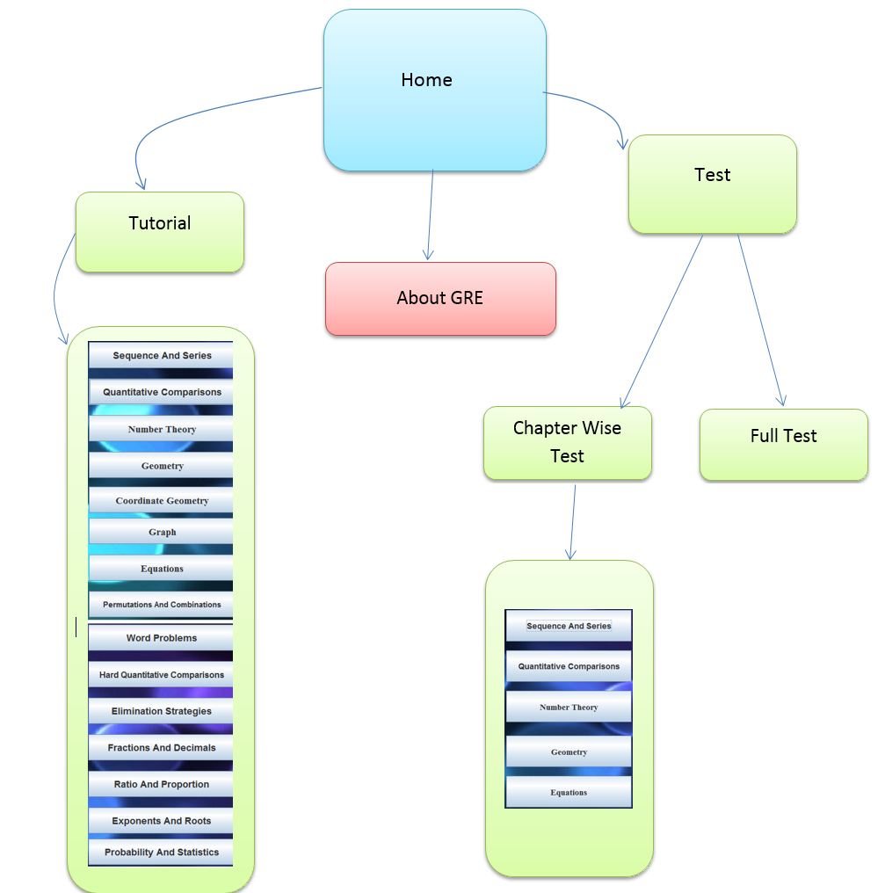

Slide 18
Implementation
Question
Choice 1
Choice 2
Choice 3
Choice 4
Correct Answer
QChoiceSet1.xml
QCorrectAns1.xml
QImage1.png

Slide 19
Limitations of GRE for Dummies
Though this software has a collection of 15 chapters, but still some chapters are missing. Those could not be added for the lack of time.
In the test section, the GRE exam format has not been implemented. This software only covers a simple practice test, not the way GRE exam is taken.

Slide 20
Possible Improvements
More chapters could be added .
GRE exam format could be maintained in the Test section.
Level wise question sorting could be done .

Slide 21
Conclusion
A lot of students who are seeking admission in graduate program oversees can be benefited from GRE for Dummies.
Helpful for digital education
So, we hope …
Those who need such an application, GRE for dummies will be of great value!!

Slide 22
Thank You!

